Slide 1
A Community of Practice on Ocean Acidification
Advancing action in the Caribbean
Alexis Valauri-Orton, The Ocean Foundation
Presenting on behalf of: Melissa Meléndez, Ana M. Palacio-Castro, Marcia Creary Ford, Gabriella Kitch, Alicia Cheripka, James Gardiner, Kerri L. Dobson, Ian C. Enochs, Erica K. Towle, & the OA in the Caribbean Task Team members

Slide 2
Our Remit
A resolution was passed at the 2019 COP to encourage collaboration with The Ocean Foundation on ocean acidification (OA) as a “regional topic of common concern.”
“Request the Secretariat to work with The Ocean Foundation … [to facilitate] collaboration on addressing ocean acidification and related issues within the Wider Caribbean Region (WCR).”

Slide 3
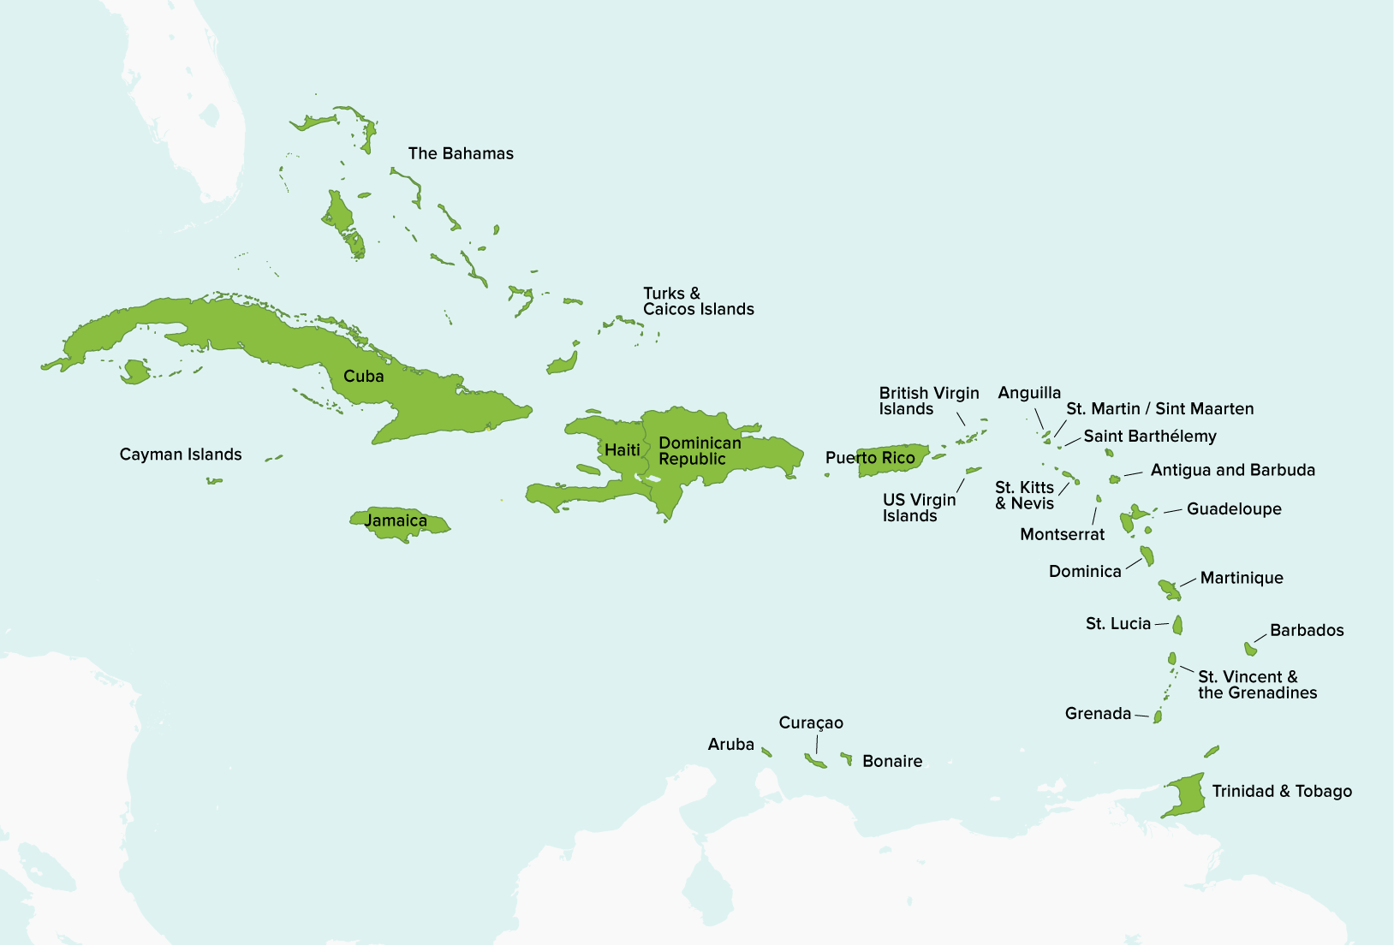
Creation of a Community of Practice (CoP)
Formed by NOAA in 2021
The CoP is open to all countries with national waters within the Caribbean Sea
Specific focus on Caribbean Small Island Developing States (SIDs)

Slide 4
Goals of the CoP
Expand connectivity and engagement in region
Identify current OA research gaps, needs, and challenges
Build and strengthen capacity to monitor and understand OA
Identify current and/or potential impacts of OA
Identify opportunities to reduce local impacts
Integrate OA science with policy

Slide 5
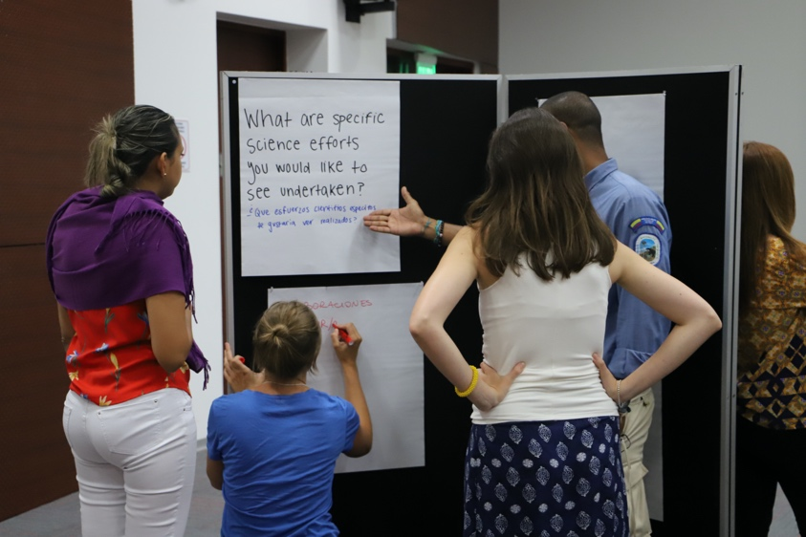
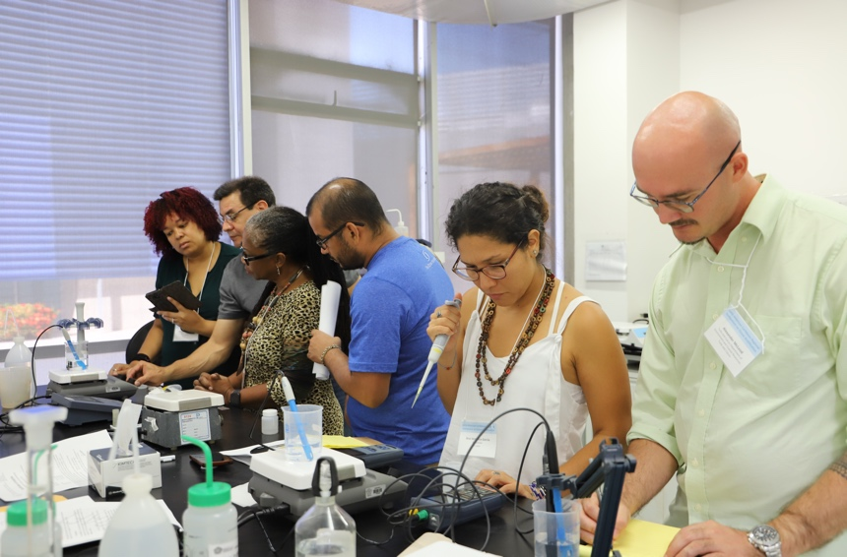
Examples of Potential Activities
Support a Regional Hub or Training Center
Secure Funding and Leverage Complementary Resources
Deliver Technical Assistance
The Global Ocean Acidification Observing Network (GOA-ON) features a grassroots regional hub model to encourage local collaboration
A regional training center would serve as a central location for training and technical support
There is no funding currently dedicated to OA in the Caribbean
There is a need to identify complementarity between the goals of CoP and existing efforts, as well as to raise additional funds
Researchers in the Caribbean have requested more technical training support and funding for or receipt of scientific instrumentation to support research

Slide 6
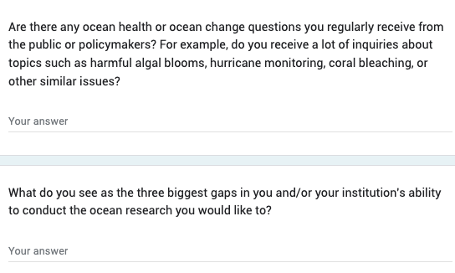
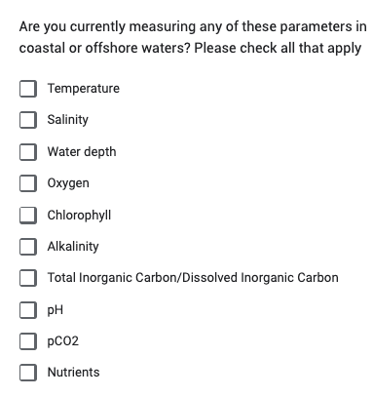
Current Activity
Conducting a regional needs assessment
Draft survey aims to assess current OA activities, potential complimentary infrastructure and projects, key infrastructure and training needs, and interest in regional coordination

Slide 7
Current Needs and Opportunities
How do we achieve our objectives?
Funding
All activities are currently unfunded and conducted on a volunteer basis
Proposed activities will require dedicated, multi-year funding support
Participation
Current CoP membership skewed towards U.S.
Need for more representation from a diversity of countries
Collaboration
There are many existing climate and ocean activities in the Caribbean
The CoP could benefit from increased collaboration with existing frameworks and projects

Slide 8
Nominate agencies/institutions/individuals to join the CoP
How can the STAC get involved?
Advise on what science and technology is needed to understand and address OA in your country
Connect the CoP to complimentary projects or frameworks
Send the survey to researchers, institutions, or agencies in your country

Slide 9
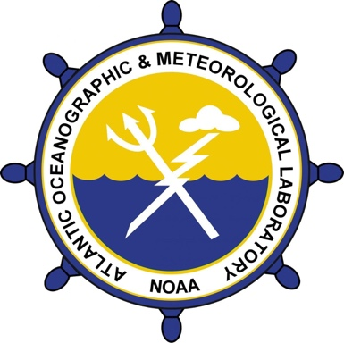
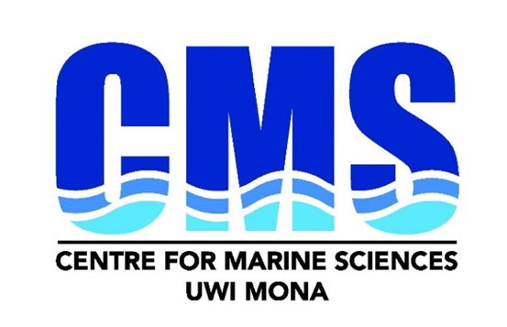
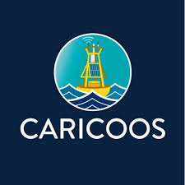
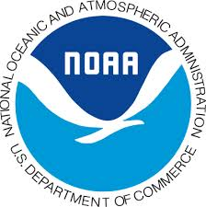
OA in the Caribbean Task Team
Alicia Cheripka – NOAA OAR International Affairs
Ana Palacio – NOAA AOML
Christopher Corbin – UNEP Caribbean Sub-Regional Office
Erica Towle – NOAA AOML
Gabby Kitch – NOAA Ocean Acidification Program
Ian Enochs – NOAA/AOML
Jair Valladarez – University of Belize
James Gardiner – US Department of State
Kaitlyn Lowder – The Ocean Foundation
Kerri Dobson – NOAA Ocean Acidification Program
Lisa Marie Carrubba – NOAA
Liza Wright-Fairbanks – NOAA Ocean Acidification Program
Marcia Creary-Ford – University of the West Indies, Mona Campus, Jamaica
Melanie McField– Healthy Reefs
Melissa Melendez –University of Hawaii at Monoa
Meredith Ryder-Rude – US Department of State
Nicholas Kee – Kee Farms, Jamaica
Sarah Wollring – UNEP Caribbean Sub-Regional Office
Tadzio Bervoets – Dutch Caribbean Nature Alliance
Alexis Valauri-Orton Program Officer
The Ocean Foundation avalauriorton@oceanfdn.org
THANK YOU

